Slide 1
LEVEL MEASUREMENTS
UNIT 3

Slide 2
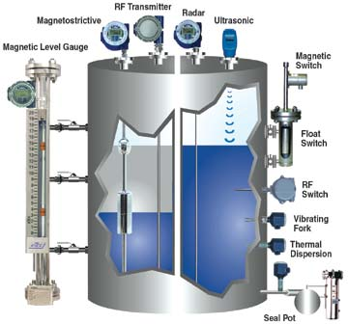
Principles to Level Measurement
Materials: liquids, powders, slurries, and granular bulk
physical principles to measure level by buoyancy, sight, pressure, radiation, electric and sonic principles

Slide 3
Sight-type
Sight-type level sensors are glass gauges and tape floats
Glass gauges are the most widely used instruments for measuring process tank level
As the liquid level in an open tank rises or falls, the liquid in the glass tube will rise or fall. The gauges consist of glass, plastic, or a combination of the two materials

Slide 4
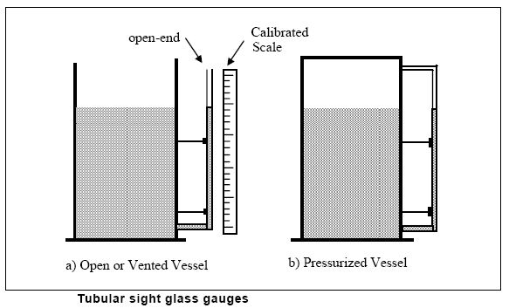
The material from which the transparent tubes are made must be able to withstand the pressure in the vessel, and they are generally limited to 450 psi at 400°F

Slide 5
Buoyancy
A float does buoyant float
Motion of the float translates can be converted into a control action
Magnetically linked devices use in industrial applications with high pressures or hazardous fluids
Displacers connect in line to a spring using a suspension cable and position themselves to rise at a force proportional to the displaced volume of the liquid

Slide 6
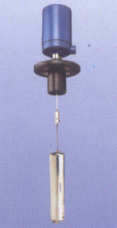
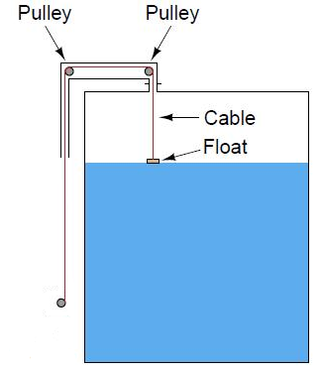
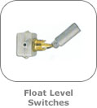

Slide 7
Magnetic level indicators
Magnetic level indicators (MLIs) consist of a float with a magnet dropped into an isolating pipe or bridle connected to the side of a tank.
The bridle can be any plastic or non- magnetic metal.
Fluid will rise and fall in the bridle, matching the level of fluid in the tank. Highly visible magnetic flags go outside the pipe to indicate the fluid level.
These devices are safer and easier to read than a sight glass.

Slide 8
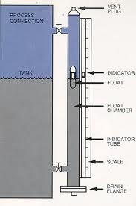
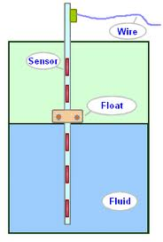

Slide 9
Level - Capacitance
Capacitance is a flexible level measurement technique that works for liquids, solids, corrosive materials, high temperatures, and pressures.
A simple metal rod, coated with insulation when used in electrically conductive fluids, turns the storage vessel into a large capacitor.
You can make on/off or continuous measurement any where on the probe.
An electronic circuit called a capacitance bridge measures the overall capacitance and provides a continuous level measurement.

Slide 10
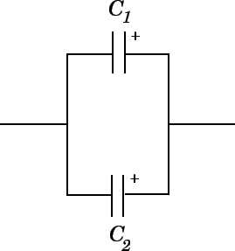
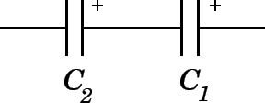



Slide 11
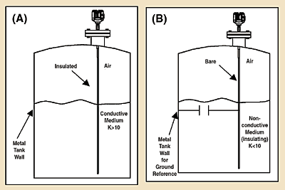
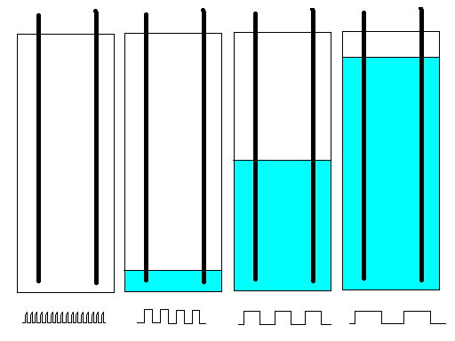
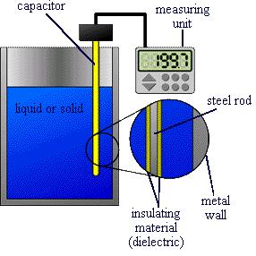
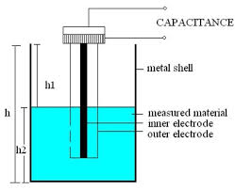

Slide 12
Capacitance..
ADVANTAGES | DISADVANTAGES
No moving parts. Compatible with vast range of liquids, powders, and granular solids. Compatible with vast range of vessel shapes. Relatively low cost compared to other electronic measurement methods. | Rely on uniform contact being maintained between liquids or solids and electrode. Must be careful to select correct electrode for application.

Slide 13
Level-Radar
Radar level measurement is based on measuring the transit time of high frequency (GHz) electromagnetic energy transmitted from an antenna at the top of the tank and reflecting off the surface of the level medium; the higher the dielectric of the medium, the stronger the reflection.
Radar comes in two forms: non-contact (through air) and contact (guided wave)

Slide 14
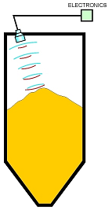
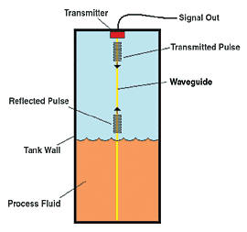

Slide 15
The transmitted energy travels freely over long distances (greater than 200 ft) and is unaffected by changes in temperature, pressure, of vapor density above the medium
High temperature (750آ°F) and high pressure (5000 psig) are possible.
Reliably picking the level signal out of the background noise (false targets) is a difficult and often unreliable process.
Contact or GWR uses a probe or waveguide to conduct the signal to the surface and back. GWR can measure in almost any application less than 100 ft.

Slide 16
Ultrasonic Level Measurement
Ultrasonic level sensors measure the time required for sound waves to travel through material
The reflected sound wave is called an echo
A generator and transmitter produce the sound waves, and a transducer sends out the sound
The measured material or level reflects the sound waves

Slide 17
A sound pulse (usually ultrasonic) is transmitted, and you can time the return reflection (or echo) from the surface of the liquid to determine distance
Non-contact ultrasonic measurement is especially suitable for corrosive and dirty applications, as well as for liquids, slurries, and bulk, solids
Ultrasonic non-contact units are limited to applications under 50 psi, 300آ°F and are not reliable in the presence of heavy surface foam

Slide 18
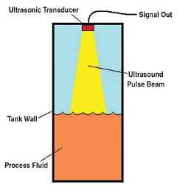

Slide 19
Level-Differential pressure
Differential pressure (DP) is a popular choice for clean liquids
If the vessel is pressurized, you need to add a second connection to the vessel above the liquid to measure and allow for correction of this variable, hence the term differential pressure, which measures the difference between these two points

Slide 20
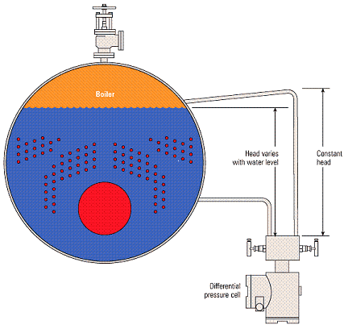

Slide 21
Variable capacitance, strain gauge or inductive techniques are used to measure the deflection of a diaphragm, and from this measurement, an electronic level signal is produced.
Applications
High-pressure water-tube boilers
Where very pure water is used, perhaps in a pharmaceutical process

Slide 22
Radiation-type Instruments
Nuclear radiation instruments have the ability to penetrate through tank walls and can be mounted on the outside of process equipment. This reduces installation and repair costs.
Nuclear systems use a low-level gamma-ray source on one side of the vessel and a radiation detector on the other side.

Slide 23
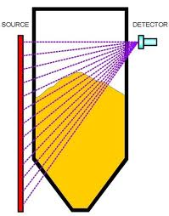

Slide 24
Nuclear radiation level measurement uses a source containing some type of radioactive material like Cesium or Cobalt located on one side of a silo while the other side contains the electronic detector.
The distinct advantages of this technique are that it is non-invasive and mounted outside the silo walls and that it is impervious to the conditions within the silo.
Disadvantages are that it is typically more expensive than others and can be installation prohibitive.

Slide 25
 | Ultrasonic | Load Cell | Radar (non contact) | Guided Wave Radar | Weight & Cable | Capacitance | Nuclear | Laser
RANGE | 200 feet |  | 328 feet | 80 feet | 60 feet | 50 feet | 90 feet | 1000 feet
Heavy dust | Caution | OK | OK | Caution - buildup | Caution | NO | OK | NO
Vacuum | NO | OK | OK | OK | OK | OK | OK | OK
Tensile forces | NO | OK | OK | Caution | Caution | Caution | OK | OK
Affects from buildup | Caution | OK | Caution | Caution | NO | NO | OK | NO
Temperature above 300 °F | NO | OK | OK | OK | OK | OK | OK | OK
Affects from external elements | NO | YES | NO | NO | NO | NO | YES | NO
Moving parts | NO | OK | NO | NO | Yes | NO | NO | NO

